Slide 1
19.2 Addressing
Internet Address
Classful Addressing
Subnetting
Supernetting
Classless Addressing

Slide 2

Note:
An IP address is a 32-bit address.

Slide 3
Note:
The IP addresses are unique and universal.

Slide 4
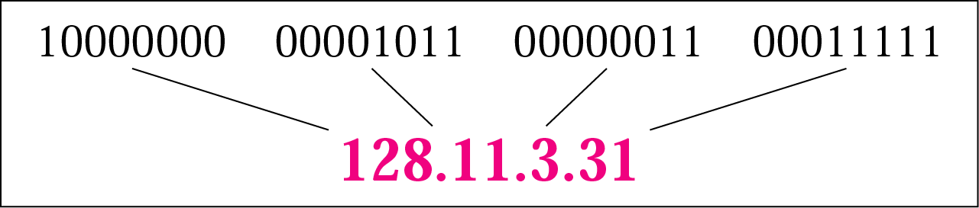
Figure 19.9 Dotted-decimal notation

Slide 5
Example 1
Change the following IP addresses from binary notation to dotted-decimal notation.
a. 10000001 00001011 00001011 11101111
b. 11111001 10011011 11111011 00001111
Solution
We replace each group of 8 bits with its equivalent decimal number (see Appendix B) and add dots for separation:
a. 129.11.11.239
b. 249.155.251.15

Slide 6
Example 2
Change the following IP addresses from dotted-decimal notation to binary notation.
a. 111.56.45.78
b. 75.45.34.78
Solution
We replace each decimal number with its binary equivalent (see Appendix B):
a. 01101111 00111000 00101101 01001110
b. 01001011 00101101 00100010 01001110

Slide 7
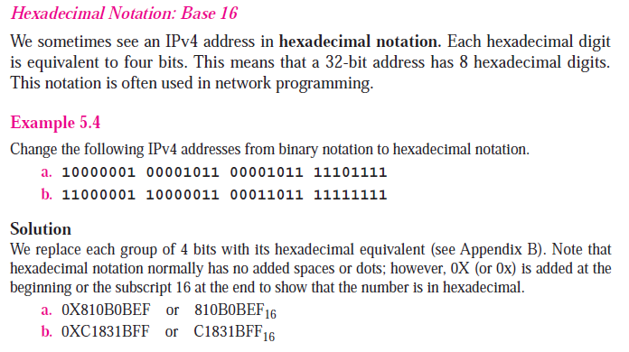

Slide 8
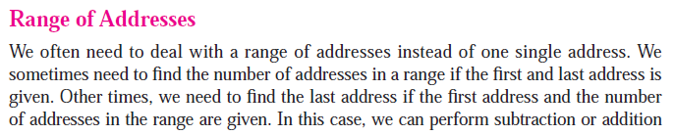

Slide 9
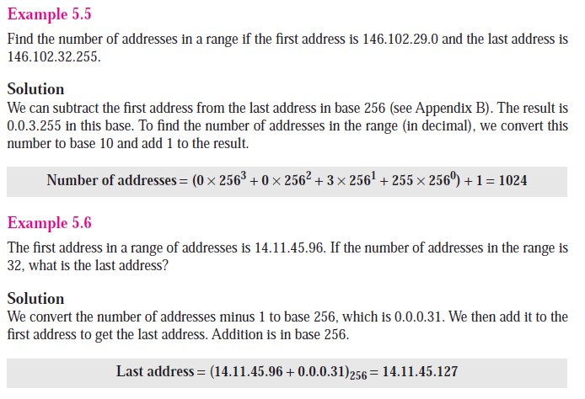

Slide 10

Classful addressing:In the classful addressing system all the IP addresses that are available are divided into the five classes A,B,C,D and E, in which class A,B and C address are frequently used because class D is for Multicast and is rarely used and class E is reserved and is not currently used.Each of the IP address belongs to a particular class that's why they are classful addresses.Earlier this addressing system did not have any name,but when classless addressing system came into existence then it is named as Classful addressing system.The main disadvantage of classful addressing is that it limited the flexibility and number of addresses that can be assigned to any device.One of the major disadvantage of classful addressing is that it does not send subnet information but it will send the complete network address. The router will supply its own subnet mask based on its locally configured subnets. As long as you have the same subnet mask and the network is contiguous, you can use subnets of a classful network address.

Slide 11
Note:
In classful addressing, the address space is divided into five classes: A, B, C, D, and E.

Slide 12
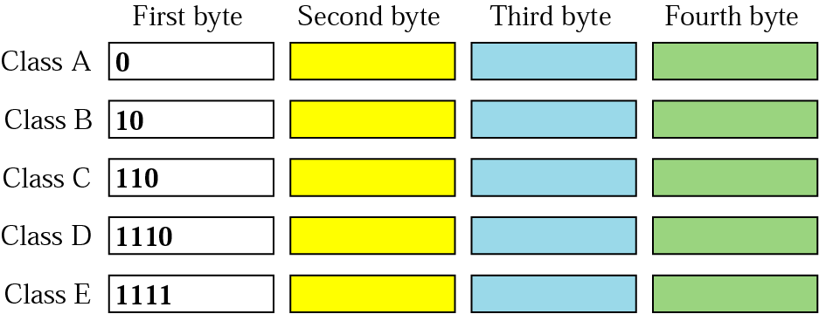
Figure 19.10 Finding the class in binary notation

Slide 13
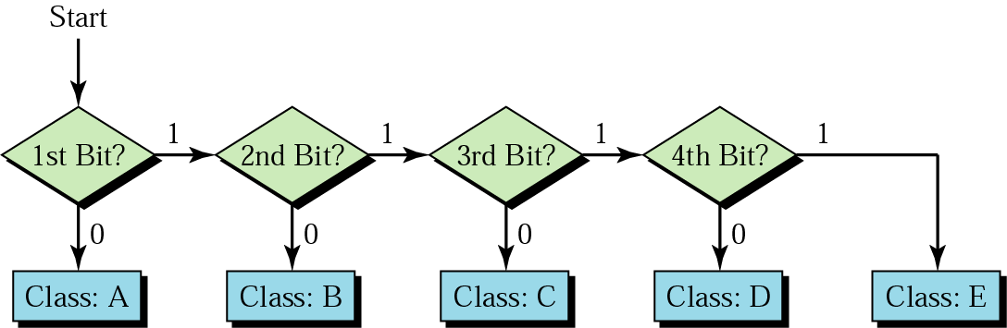
Figure 19.11 Finding the address class

Slide 14
Example 3
Find the class of each address:
a. 00000001 00001011 00001011 11101111
b. 11110011 10011011 11111011 00001111
Solution
See the procedure in Figure 19.11.
a. The first bit is 0; this is a class A address.
b. The first 4 bits are 1s; this is a class E address.

Slide 15
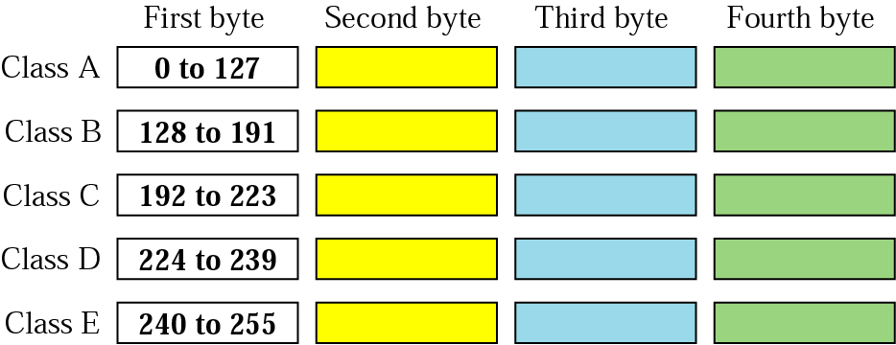
Figure 19.12 Finding the class in decimal notation

Slide 16
Example 4
Find the class of each address:
a. 227.12.14.87
b. 252.5.15.111
c. 134.11.78.56
Solution
a. The first byte is 227 (between 224 and 239); the class is D.
b. The first byte is 252 (between 240 and 255); the class is E.
c. The first byte is 134 (between 128 and 191); the class is B.

Slide 17
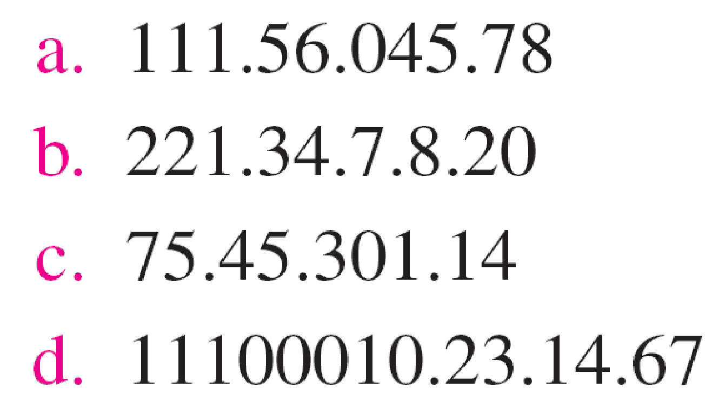
Example 19.3
Find the error, if any, in the following IPv4 addresses.
Solution
a. There must be no leading zero (045).
b. There can be no more than four numbers.
c. Each number needs to be less than or equal to 255.
d. A mixture of binary notation and dotted-decimal notation is not allowed.

Slide 18
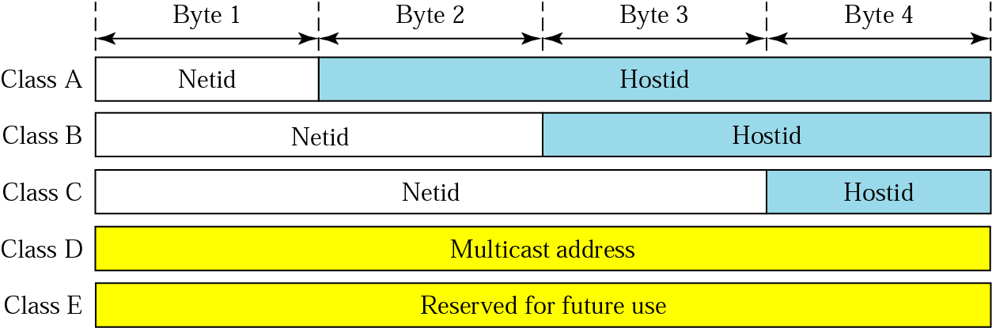
Figure 19.13 Netid and hostid

Slide 19
The netid defines the network;
The hostid defines a particular host connected to that network.

Slide 21
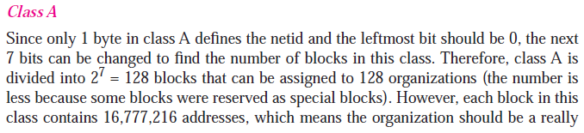
2^(32-n)=block size…… eg: 2^(32-8)=2^24=16777216 for class A

Slide 22
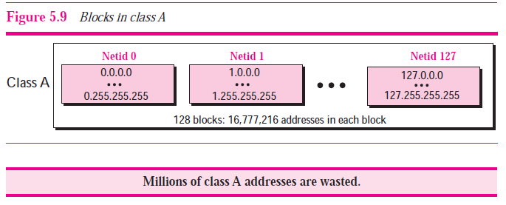

Slide 23
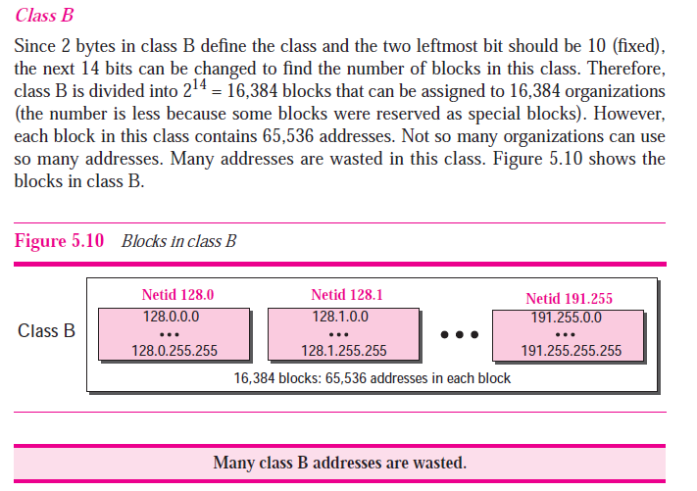
2^(32-16)=block size…… eg: 2^(32-16)=2^16=65536 for class B

Slide 24
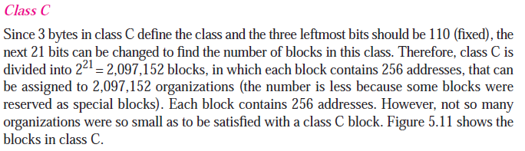

Slide 25
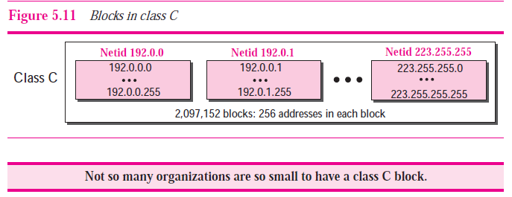
2^(32-n)=block size…… eg: 2^(32-24)=2^8=256 for class C

Slide 26
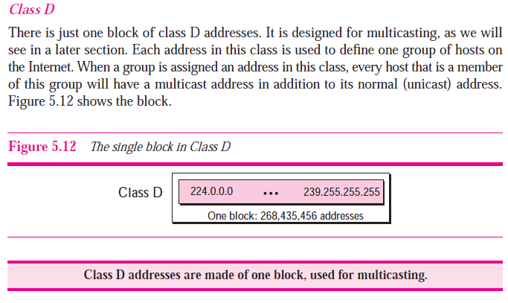

Slide 27
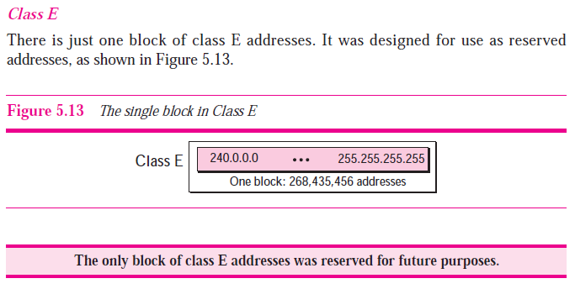

Slide 28
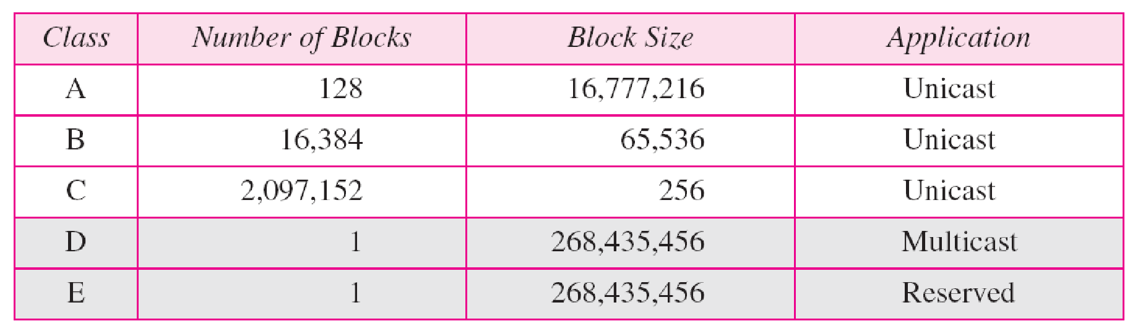
Table 19.1 Number of blocks and block size in classful IPv4 addressing
2^(32-n)=block size…… eg: 2^(32-24)=2^8=256 for class C

Slide 29
Extracting Information in a Block
three pieces of information about the block:
the number of addresses,
the first address
the last address

Slide 30
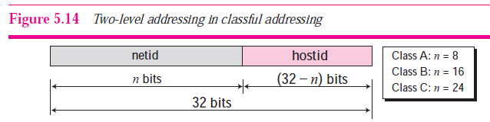

Slide 31
1. The number of addresses in the block, N, can be found using N = 2^(32−n).
2. To find the first address, we keep the n leftmost bits and set the (32 − n) rightmost bits all to 0s.
3. To find the last address, we keep the n leftmost bits and set the (32− n) rightmost bits all to 1s.

Slide 32
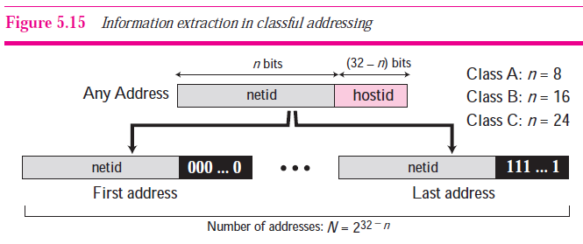

Slide 33
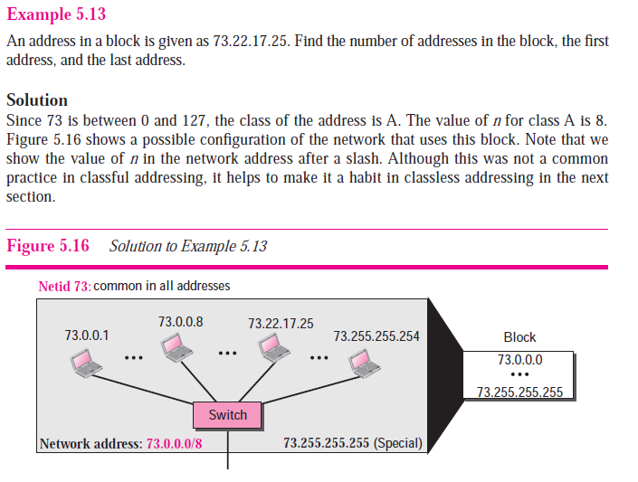

Slide 34
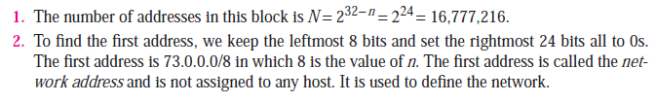

Slide 35
Example 2

Slide 36
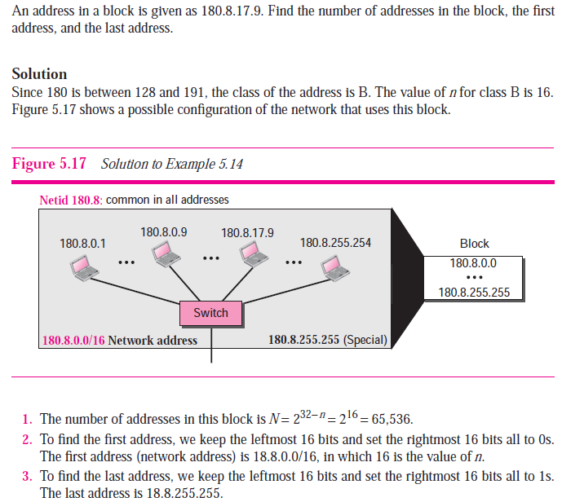

Slide 37
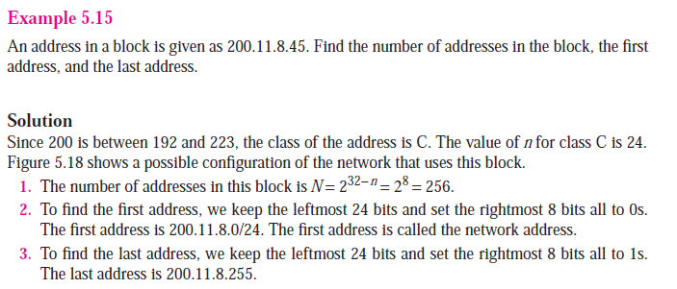

Slide 38
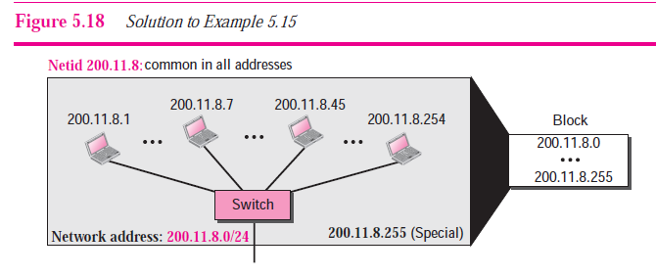

Slide 39
Network mask
A network mask or a default mask in classful addressing is a:
32-bit number with n leftmost bits all set to 1s and (32 − n) rightmost bits all set to 0s.
Since n is different for each class in classful addressing, we have three default masks in classful addressing

Slide 40
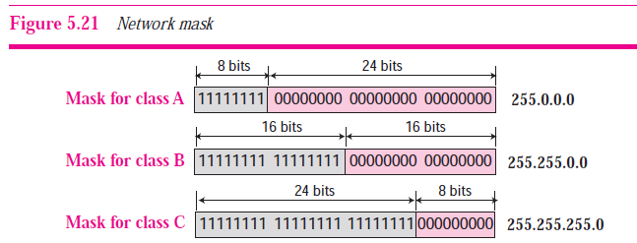

Slide 41
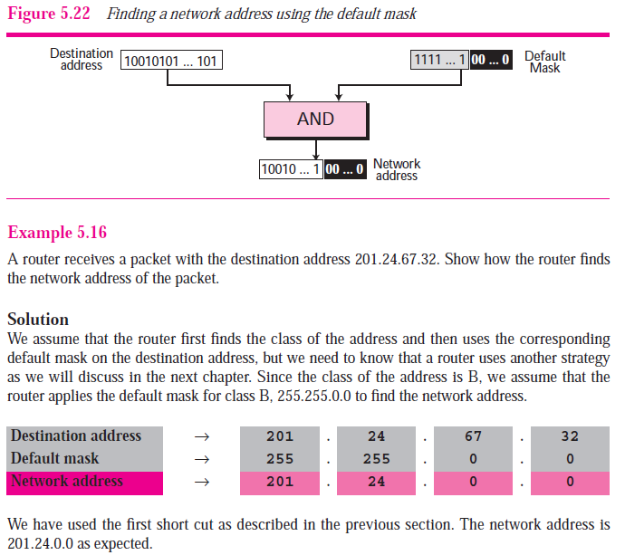
255
67

Slide 42
Mask
A mask is a 32-bit binary number that gives the first address in the block (the network address) when bitwise ANDed with an address in the block.

Slide 43

The network address is the beginning address of each block. It can be found by applying the default mask to any of the addresses in the block (including itself). It retains the netid of the block and sets the hostid to zero.

Slide 44
Example 12
Given the address 23.56.7.91 and the default class A mask, find the beginning address (network address).
Solution
The default mask is 255.0.0.0, which means
that only the first byte is preserved
and the other 3 bytes are set to 0s.
The network address is 23.0.0.0.

Slide 45
Example 13
Given the address 132.6.17.85 and the default class B mask, find the beginning address (network address).
Solution
The default mask is 255.255.0.0, which means
that the first 2 bytes are preserved
and the other 2 bytes are set to 0s.
The network address is 132.6.0.0.

Slide 46
Example 14
Given the address 201.180.56.5 and the class C default mask, find the beginning address (network address).
Solution
The default mask is 255.255.255.0,
which means that the first 3 bytes are
preserved and the last byte is set to 0.
The network address is 201.180.56.0.

Slide 47
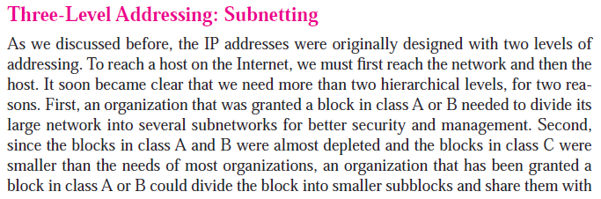


Slide 48
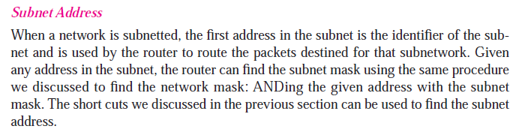
Subnet mask
A subnet has a subnetid and hostid

Slide 49
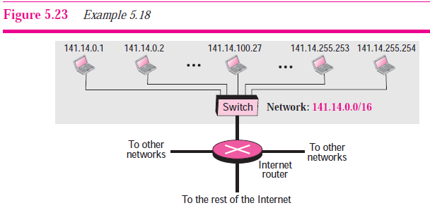

Slide 50
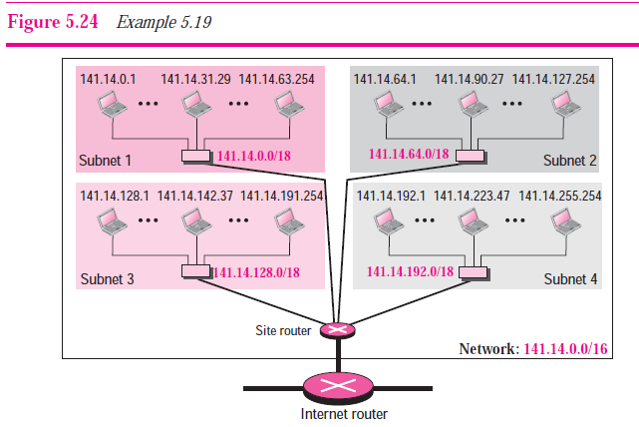

Slide 51
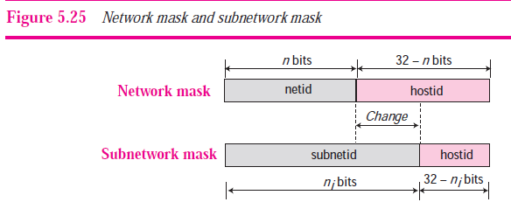

Slide 52
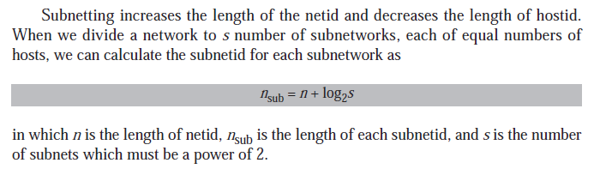

Slide 53
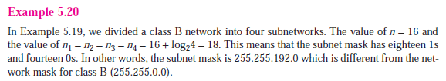

Slide 54
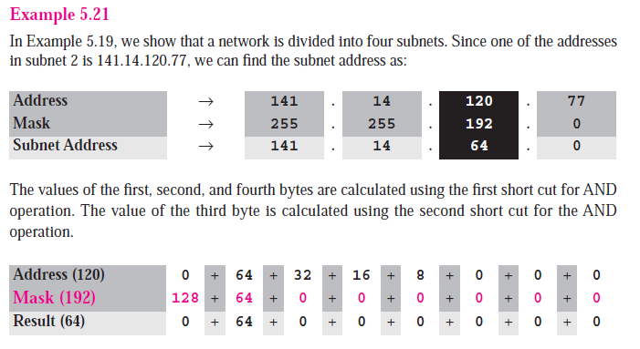

Slide 55
Finding the Subnet Address
Given an IP address, we can find the subnet address the same way we found the network address in the previous chapter. We apply the mask to the address. We can do this in two ways: straight or short-cut.

Slide 56
Straight Method
In the straight method, we use binary notation for both the address and the mask and then apply the AND operation to find the subnet address.

Slide 57
Example 1
What is the subnetwork address if the destination address is 200.45.34.56 and the subnet mask is 255.255.240.0?

Slide 58
Solution
11001000 00101101 00100010 00111000
11111111 11111111 11110000 00000000
11001000 00101101 00100000 00000000
The subnetwork address is 200.45.32.0.

Slide 59
Short-Cut Method
** If the byte in the mask is 255, copy the byte in the address.
** If the byte in the mask is 0, replace the byte in the address with 0.
** If the byte in the mask is neither 255 nor 0, we write the mask and the address in binary and apply the AND operation.

Slide 60
Example 2
What is the subnetwork address if the destination address is 19.30.84.5 and the mask is 255.255.192.0?
Solution
See Figure 5.6

Slide 61
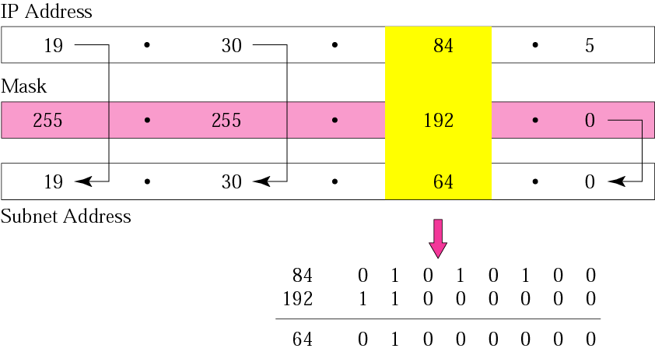
Figure 5-6
Example 2
And operation

Slide 62
The number of subnets must be a power of 2.

Slide 63
Example 3
A company is granted the site address 201.70.64.0 (class C). The company needs six subnets. Design the subnets.
Solution
The number of 1s in the default mask is 24 (class C).

Slide 64
Solution (Continued)
The company needs six subnets. This number 6 is not a power of 2. The next number that is a power of 2 is 8 (2³). We need 3 more 1s in the subnet mask. The total number of 1s in the subnet mask is 27 (24 + 3).
The total number of 0s is 5 (32 − 27).

Slide 65
Solution (Continued)
11111111 11111111 11111111 11100000
or
255.255.255.224
The number of subnets is 8.
The number of addresses in each subnet is 2⁵ (5 is the number of 0s) or 32.
See Figure 5.8

Slide 66
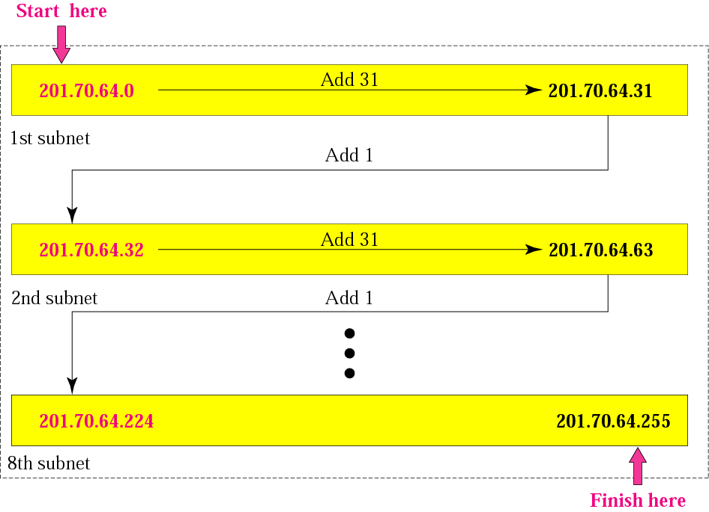
Figure 5-8
Example 3

Slide 67
Example 4
A company is granted the site address 181.56.0.0 (class B). The company needs 1000 subnets. Design the subnets.
Solution
The number of 1s in the default mask is 16 (class B).

Slide 68
Solution (Continued)
The company needs 1000 subnets. This number is not a power of 2. The next number that is a power of 2 is 1024 (2¹⁰). We need 10 more 1s in the subnet mask.
The total number of 1s in the subnet mask is 26 (16 + 10).
The total number of 0s is 6 (32 − 26).

Slide 69
Solution (Continued)
The mask is
11111111 11111111 11111111 11000000
or
255.255.255.192.
The number of subnets is 1024.
The number of addresses in each subnet is 2⁶
(6 is the number of 0s) or 64.
See Figure 5.9

Slide 70
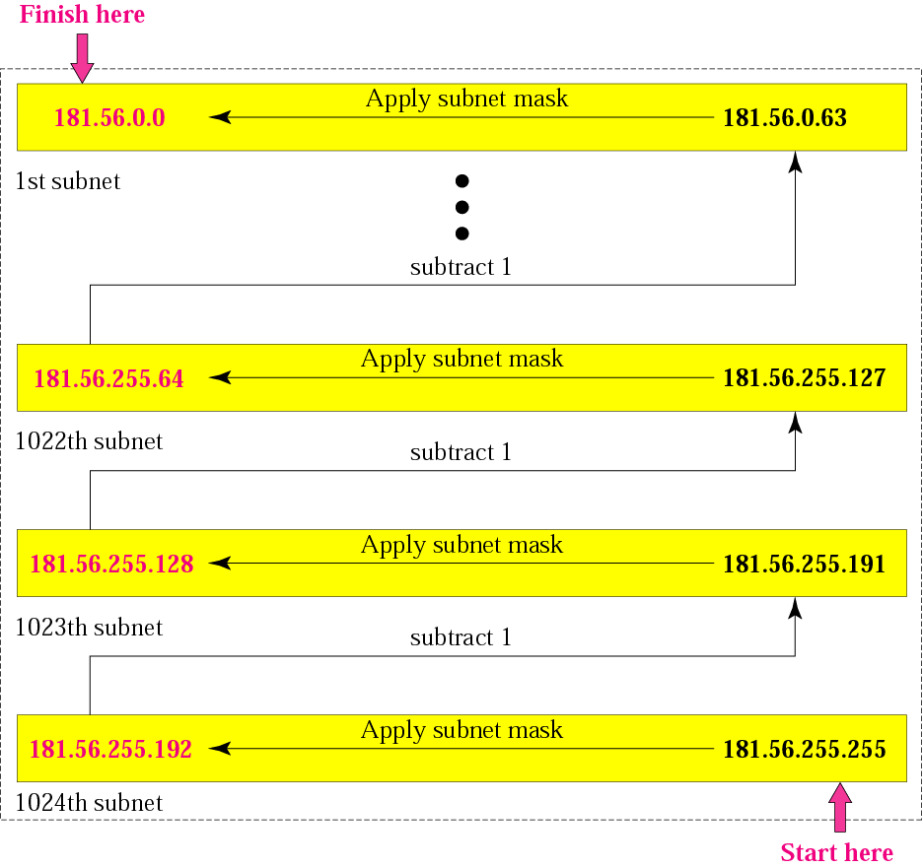
Figure 5-9
Example 4

Slide 71
5.2
SUPERNETTING

Slide 72
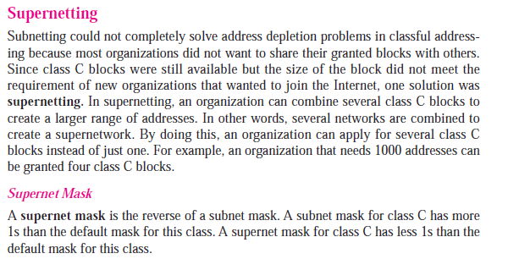

Slide 73
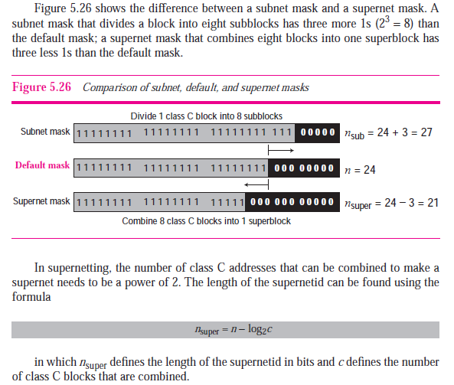

Slide 74


Slide 75
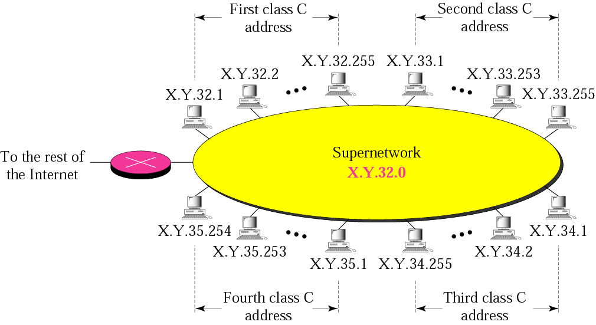
Figure 5-11
A supernetwork

Slide 76
Rules:
** The number of blocks must be a power of 2 (1, 2, 4, 8, 16, . . .).
** The blocks must be contiguous in the address space (no gaps between the blocks).
** The third byte of the first address in the superblock must be evenly divisible by the number of blocks. In other words, if the number of blocks is N, the third byte must be divisible by N.

Slide 77
Example 5
A company needs 600 addresses. Which of the following set of class C blocks can be used to form a supernet for this company?
198.47.32.0 198.47.33.0 198.47.34.0
198.47.32.0 198.47.42.0 198.47.52.0 198.47.62.0
198.47.31.0 198.47.32.0 198.47.33.0 198.47.52.0
198.47.32.0 198.47.33.0 198.47.34.0 198.47.35.0

Slide 78
Solution
1: No, there are only three blocks.
2: No, the blocks are not contiguous.
3: No, 31 in the first block is not divisible by 4.
4: Yes, all three requirements are fulfilled.

Slide 79
In subnetting, we need the first address of the subnet and the subnet mask to define the range of addresses.

Slide 80
In supernetting, we need the first address of the supernet and the supernet mask to define the range of addresses.

Slide 81
5.3
CLASSLESS
ADDRESSING

Slide 82
Classless Addressing:Classless addressing system is also known as CIDR(Classless Inter-Domain Routing).Classless addressing is a way to allocate and specify the Internet addresses used in inter-domain routing more flexibly than with the original system of Internet Protocol (IP) address classes.What happened in classful addressing is that if any company needs more than 254 host machines but far fewer than the 65,533 host addresses then the only option for the company is to take the class B address.Now suppose company needs only 1000 IP addresses for its host computers then in this (65533-1000=64533) IP addresses get wasted.For this reason, the Internet was, until the arrival of CIDR, running out of address space much more quickly than necessary. CIDR effectively solved the problem by providing a new and more flexible way to specify network addresses in routers.A CIDR network address looks like this:

Slide 83
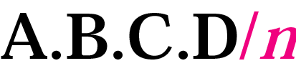
Figure 5-14
Slash notation

Slide 84
Slash notation is also called CIDR notation.

Slide 85
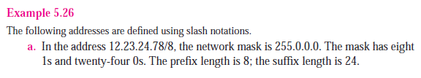
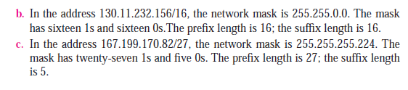

Slide 86
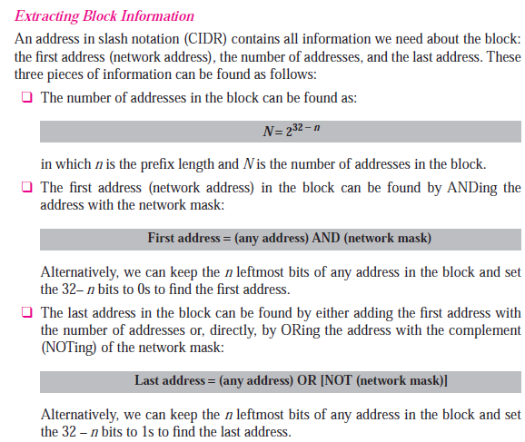

Slide 87
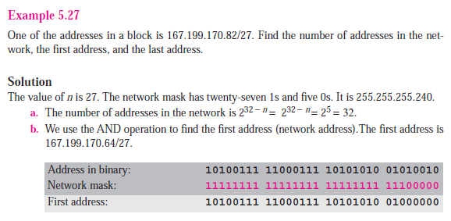

Slide 88
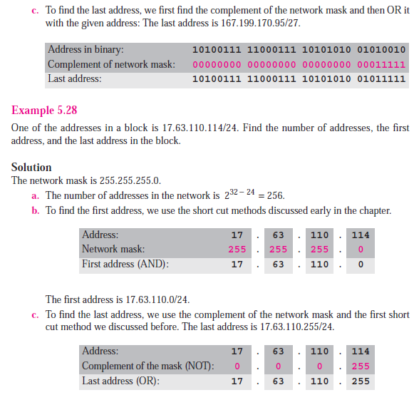

Slide 89
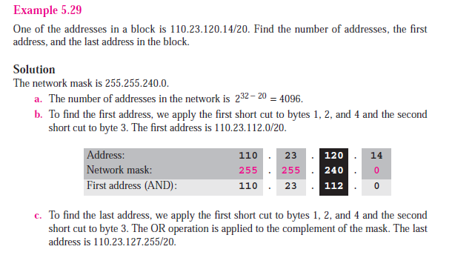


Slide 91
Example 11
A small organization is given a block with the beginning address and the prefix length 205.16.37.24/29 (in slash notation). What is the range of the block and last address?

Slide 92
Example 11
A small organization is given a block with the beginning address and the prefix length 205.16.37.24/29 (in slash notation). What is the range of the block and last address?
The beginning address is 205.16.37.24. To find the last address we keep the first 29 bits and change the last 3 bits to 1s.
Beginning:11001111 00010000 00100101 00011000
Ending : 11001111 00010000 00100101 00011111
There are only 8 addresses in this block.
24 or (not(255.255.255.11111000))
00011000 or 00000111= 00011111=31
Therefore: last address will be 203.16.37.31
Solution

Slide 93
A block in classes A, B, and C can easily be represented in slash notation as A.B.C.D/ n where n is either 8 (class A), 16 (class B), or 24 (class C).

Slide 94
Example 13
What is the network address if one of the addresses is 167.199.170.82/27?

Slide 95
Example 13
What is the network address if one of the addresses is 167.199.170.82/27?
Solution
The prefix length is 27, which means that we must keep the first 27 bits as it is and change the remaining bits (5) to 0s. The 5 bits affect only the last byte. The last byte is 01010010=82. Changing the last 5 bits to 0s, we get 01000000 or 64. The network address is 167.199.170.64/27.

Slide 96
Calculate the last address also:
167.199.170.95 is the answer
82 in binary : 01010010
Mask complement for last byte: 00011111
Applying or operation:
01010010 or 00011111=01011111=95

Slide 97
Example 14
An organization is granted the block 130.34.12.64/26. The organization needs to have four subnets. What are the subnet addresses and the range of addresses for each subnet?
Solution
The suffix length is 6. This means the total number of addresses in the block is 64 (2⁶). If we create four subnets, each subnet will have 16 addresses.

Slide 98
Solution (Continued)
Let us first find the subnet prefix (subnet mask). We need four subnets, which means we need to add two more 1s to the site prefix. The subnet prefix is then /28 (i.e 26+log(4)=28)
Subnet 1: 130.34.12.64/28 to 130.34.12.79/28.
Subnet 2 : 130.34.12.80/28 to 130.34.12.95/28.
Subnet 3: 130.34.12.96/28 to 130.34.12.111/28.
Subnet 4: 130.34.12.112/28 to 130.34.12.127/28.

Slide 99
Example 15
An ISP is granted a block of addresses starting with 190.100.0.0/16. The ISP needs to distribute these addresses to three groups of customers as follows:
1. The first group has 64 customers; each needs 256 addresses.
2. The second group has 128 customers; each needs 128 addresses.
3. The third group has 128 customers; each needs 64 addresses. Design the subblocks and give the slash notation for each subblock. Find out how many addresses are still available after these allocations.

Slide 100
Solution
Group 1
For this group, each customer needs 256 addresses. This means the suffix length is 8 (2⁸ = 256). The prefix length is then 32 − 8 = 24.
01: 190.100.0.0/24 🡺190.100.0.255/24
02: 190.100.1.0/24 🡺190.100.1.255/24
…………………………………..
64: 190.100.63.0/24🡺190.100.63.255/24
Total = 64 × 256 = 16,384

Slide 101
Solution (Continued)
Group 2
For this group, each customer needs 128 addresses. This means the suffix length is 7 (2⁷ = 128). The prefix length is then 32 − 7 = 25. The addresses are:
001: 190.100.64.0/25 190.100.64.127/25
002: 190.100.64.128/25 190.100.64.255/25
128: 190.100.127.128/25 190.100.127.255/25
Total = 128 × 128 = 16,384

Slide 102
Solution (Continued)
Group 3
For this group, each customer needs 64 addresses. This means the suffix length is 6 (2⁶ = 64). The prefix length is then 32 − 6 = 26.
001:190.100.128.0/26 🡺190.100.128.63/26
002:190.100.128.64/26 🡺190.100.128.127/26
…………………………
Total = 128 × 64 = 8,192
0-63
64-127
128-191
192-255

Slide 103
Last 128th customer will have the address block ranging from :
190.100.159.192 to 190.100.159.255

Slide 104
Solution (Continued)
2^16… class B address
Number of granted addresses: 65,536
Number of allocated addresses: 40,960
Number of available addresses:
(65,536- 40,960=)24,576

Slide 105
The main difference between classful and classless addressing is that classless addressing allows allocating IP addresses more efficiently than classful addressing. In brief, classless addressing can avoid running out of IP addresses that can occur in classful addressing

Slide 106
Disadvantage of Classful Addressing:
Class A with a mask of 255.0.0.0 can support 16, 777, 214 addresses
Class B with a mask of 255.255.0.0 can support 65, 534 addresses
Class C with a mask of 255.255.255.0 can support 254 addresses
But what if someone requires 2000 addresses ? One way to address this situation would be to provide the person with class B network. But that would result in a waste of so many addresses. Another possible way is to provide multiple class C networks, but that too can cause a problem as there would be too many networks to handle.
To resolve problems like the one mentioned above CIDR was introduced.

